Slide 1
ENEL 441
Control Systems I
Arne Dankers
10-01-2023

Slide 2
Course Outline – Learning Outcomes
System Modelling and Representations
Construct mathematical models of electrical, mechanical and mechatronic systems,
Represent and analyze a system using transfer function and state-space representations,
Determine properties of the transient response of a given system (rise-time, overshoot, settling time) using s-plane plots.
Introduction to Control
List 4 common objectives of feedback and how to implement controllers to achieve those objectives by analyzing sensitivity functions and loop shaping,
Determine the stability and robustness of a feedback system using Nyquist and Bode plots.
PID control
Design P controllers using Root Locus plots. Design PD, PI and PID controllers to meet design requirements.
Lead/Lag Compensators
Design lead/lag compensators to meet design requirements
Control Design Using State Feedback
Design controllers using state feedback (pole placement) to meet design requirements.

Slide 3
Controls is when mathematics comes alive!
I will attempt to connect theory to practice. Show how the mathematical world view of an engineer is implemented in practice.
Many of the tools you have learned so far will be used in this course
You will develop useful skills along the way (Python, modelling, systems viewpoint).

Slide 4
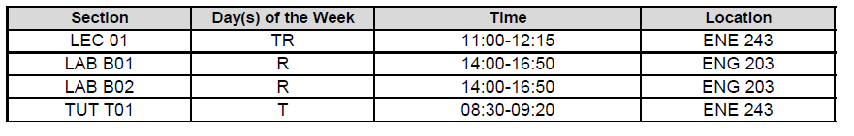
Timetable
The first lab will start on Feb 9 (B01) and Feb 16 (B02)

Slide 5
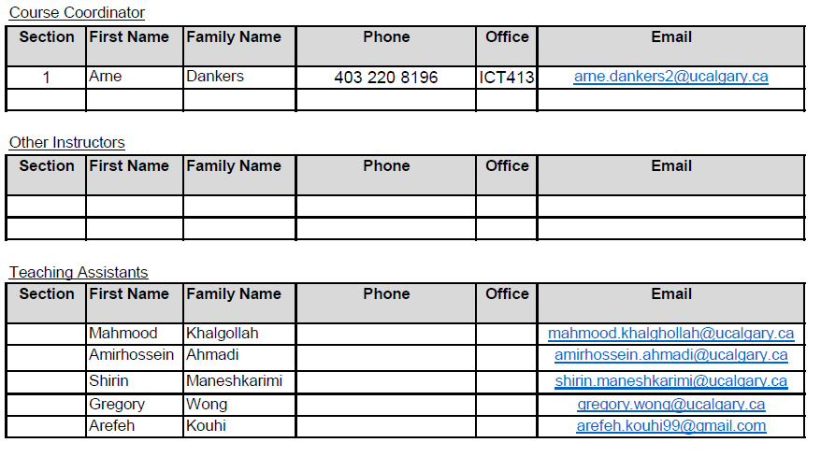
Course Instructors

Slide 6
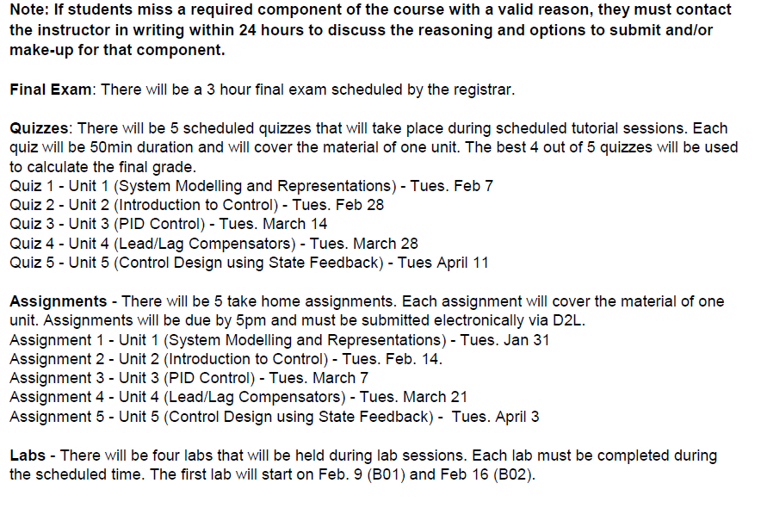
Assessments

Slide 7
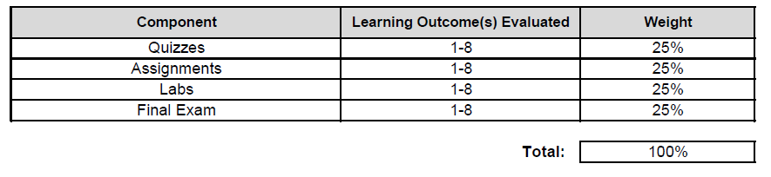
Final Grade Determination

Slide 8
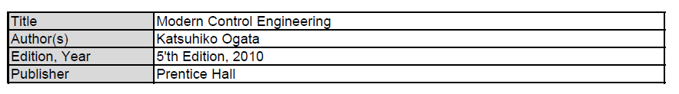
Textbook

Slide 9
Course Delivery - Lectures
Mix between lecturing and tutorial style
Technical content will be posted in videos on D2L. Watch the assigned videos before class.
In class activities will consist of
Pencil and paper exercises
Python exercises (focused on exploration not coding). Please bring a laptop, sit together around someone with a laptop, or contact me to borrow a laptop.
Mentimeter question and answer sessions.

Slide 10
Course Delivery - Tutorials
Will focus on in class activities:
Pencil and paper exercises
Python exercises
Quizzes will be held during tutorials.

Slide 11
Course Delivery - Labs
4 labs
Simulation based (Python)
Completed and handed in during the scheduled sessions

Slide 12
Test Mentimeter

Slide 13
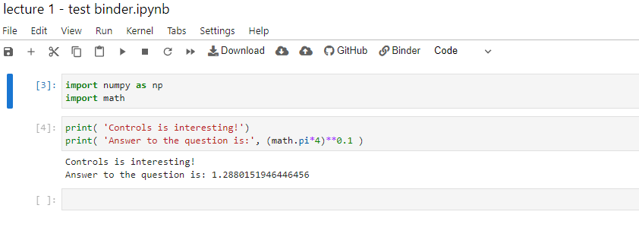

Test - Running Python Jupyter Notebooks using Binder
Click on the link: https://mybinder.org/v2/gh/arneUofC/Lecture-1---Introduction/HEAD?labpath=lecture%201%20-%20test%20binder.ipynb
This should launch a Jupyter Notebook (although it may take a little while).
Should see something like:
Once the notebook launches, click on the “run” button and run all the cell in the notebook. You can also run cells by pressing Shift+Enter while the cell is active.
Click here to run cell

